Slide 1
…Parte 1

Slide 2

Frozen Argon Crystal

Slide 3
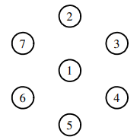
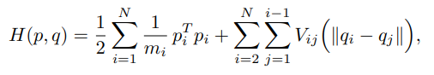
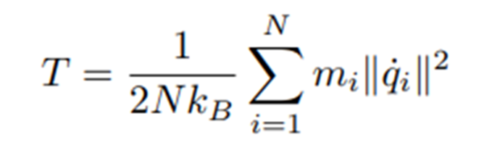
Mathematical model
Seven argon atoms in a plane
Hamiltonian system:
Temperature computation:
T₀ ≈ 22.72 [K]
H(p₀,q₀) ≈ −1260.2 · k_{B} [J]

Slide 4
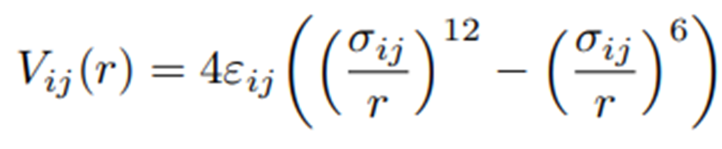
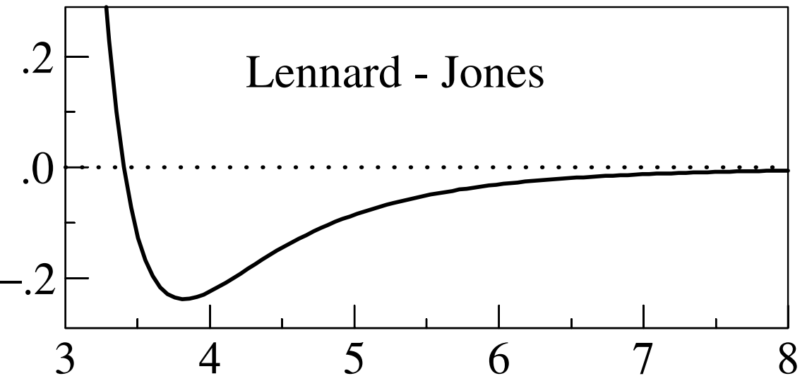
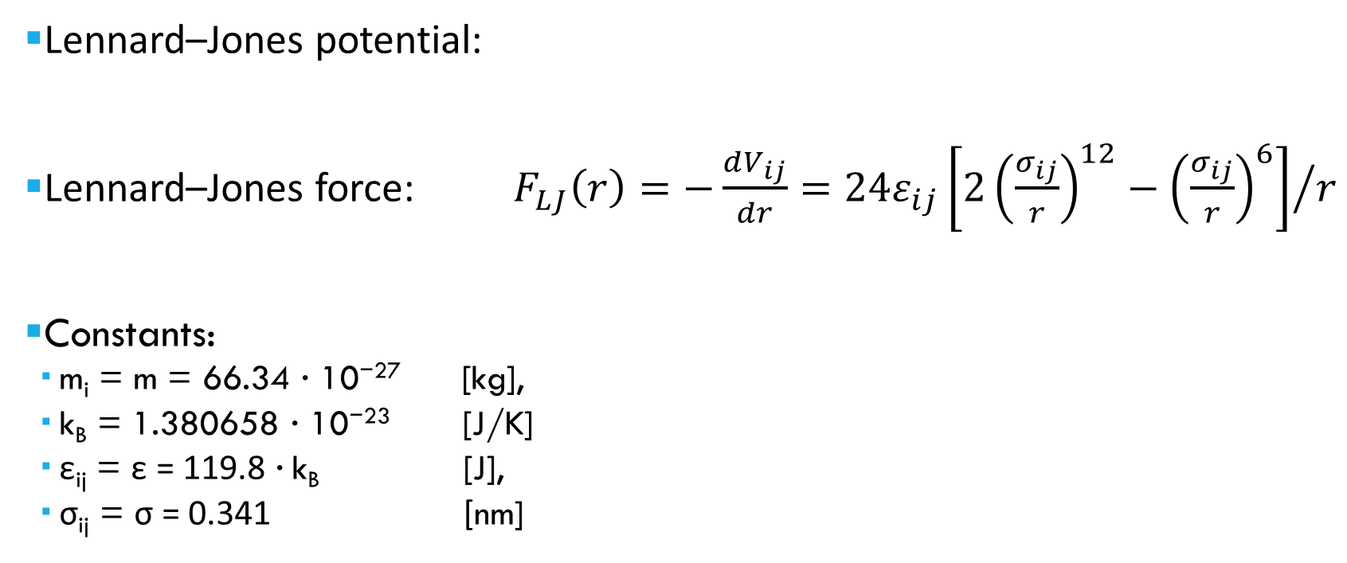
Mathematical model
Lennard–Jones potential:
Lennard–Jones force: $F_{LJ}\left(r\right)=−\frac{dV_{ij}}{dr}=24ε_{ij}{\left[2{\left(\frac{σ_{ij}}{r}\right)}^{12}−{\left(\frac{σ_{ij}}{r}\right)}^{6}\right]}/r$
Constants:
m_{i} = m = 66.34 · 10⁻²⁷ [kg],
k_{B} = 1.380658 · 10⁻²³ [J/K]
ε_{ij} = ε = 119.8 · k_{B} [J],
σ_{ij} = σ = 0.341 [nm]

Slide 5
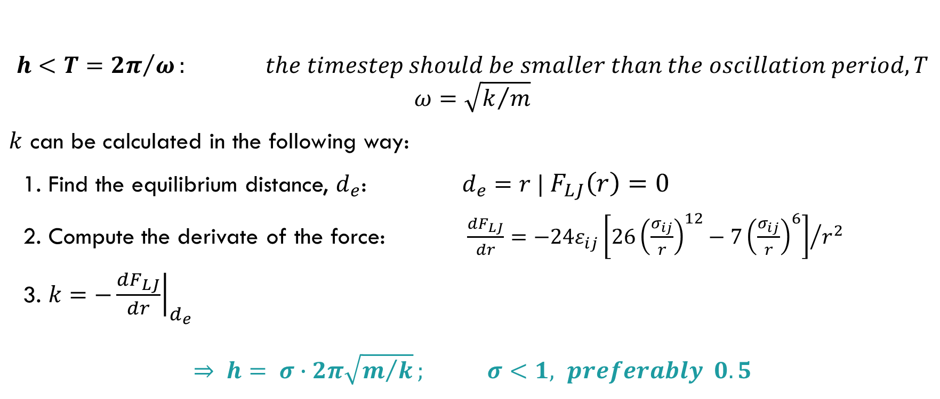
How to properly Choose the timestep h
$$h<T={2π}/ω: the timestep should be smaller than the oscillation period, T$$
can be calculated in the following way:
1. Find the equilibrium distance, $d_{e}$: $d_{e}=r | F_{LJ}\left(r\right)=0$
2. Compute the derivate of the force: $\frac{dF_{LJ}}{dr}=−24ε_{ij}{\left[26{\left(\frac{σ_{ij}}{r}\right)}^{12}−7{\left(\frac{σ_{ij}}{r}\right)}^{6}\right]}/{r^{2}}$
3. $k=−{\left.\frac{dF_{LJ}}{dr}\right|}_{d_{e}}$
$$⇒ h= σ∙2π\sqrt{m/k}; σ<1, lpreferably 0.5$$

Slide 6
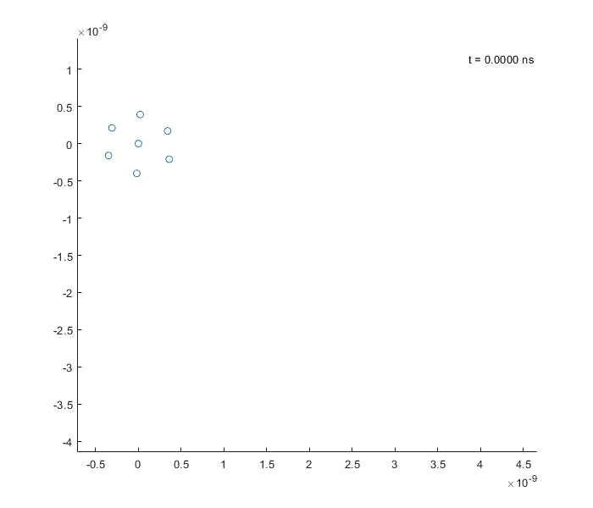
Forward Euler method
As we can observe, at around t = 0,03 ns the system loses definetly its original configuration.
This is in accordance with the following plots.

Slide 7
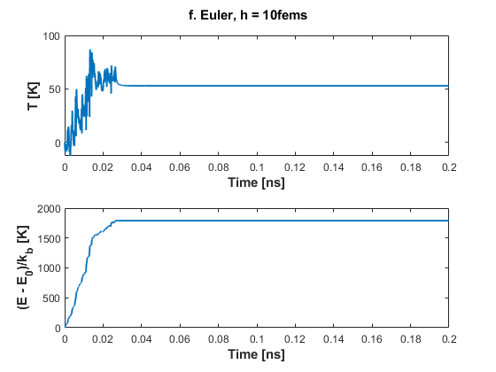
Forward Euler method
This method shows uncorrect results both for the T and the H, therefore it is completely ineffective.
Energy in fact is not conserved but instead increases.

Slide 8
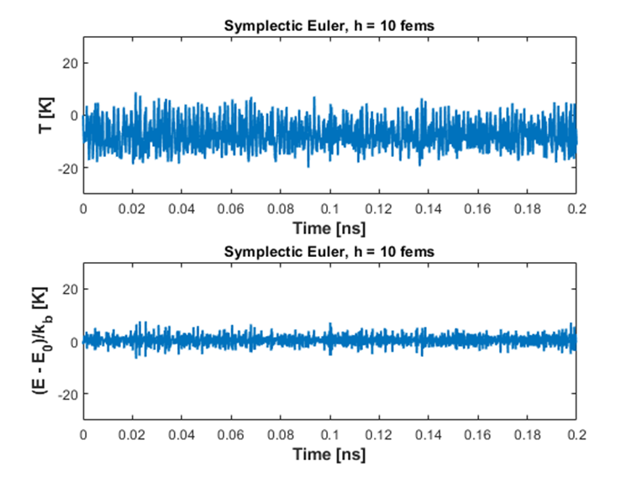
Symplectic Euler Method
This method can be applied, since it gives correct results both for the T and the H, thus the simulation is enough close to reality.
In fact energy is conserved, unlike the Forward Euler.

Slide 9
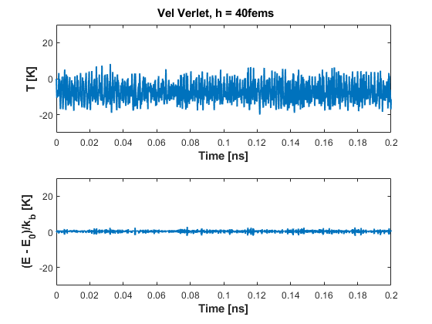
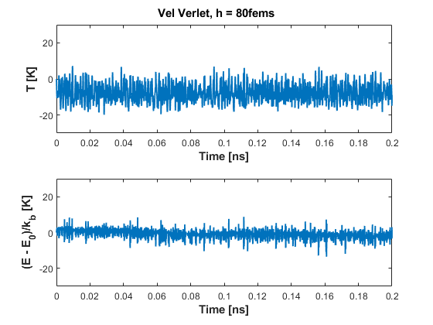
Velocity Verlet
This is the method manages to achieve a pseudo conservation of energy.
Moreover, it is qualitatively correct regarding also the calculation of T, p and q.

Slide 10
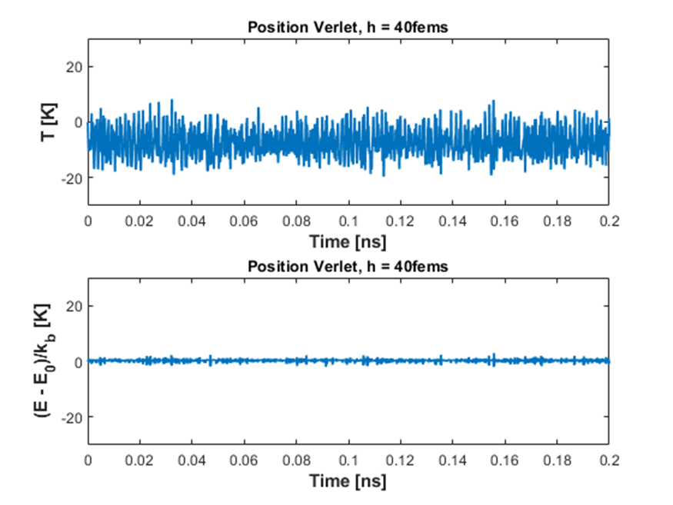
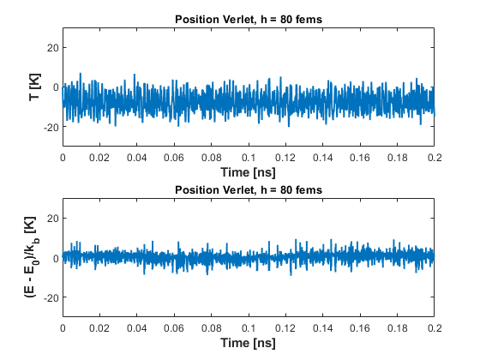
Position Verlet
Results similar to those of the Velocity Verlet, therefore it can be considered accurate and reliable.

Slide 11
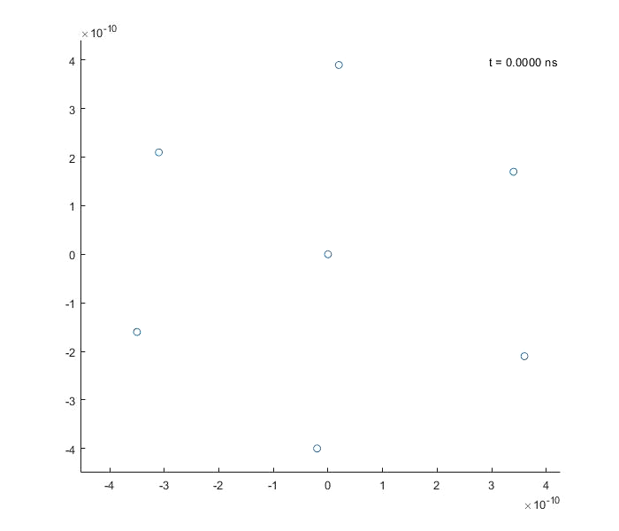
.
Velocity Verlet Method

Slide 12
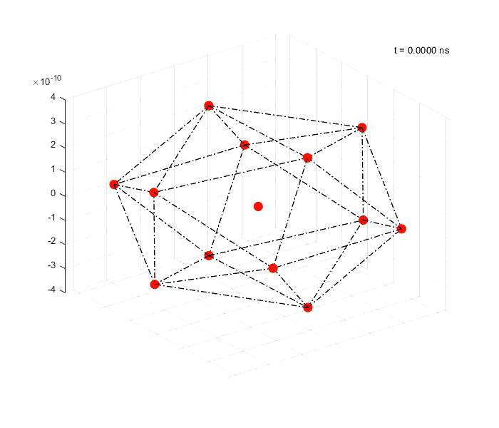
3d argon crystal simulation
Icosahedron structure:
Argon atoms
Coordinates:
(0, ±1, ±φ) x4
(±1, ±φ, 0) x4
(±φ, 0, ±1) x4
(0, 0, 0) x1
p0 = zeros(1,13);
Method: Velocity Verlet
φ is around 1,618 and is also known as the golden ratio

Slide 13
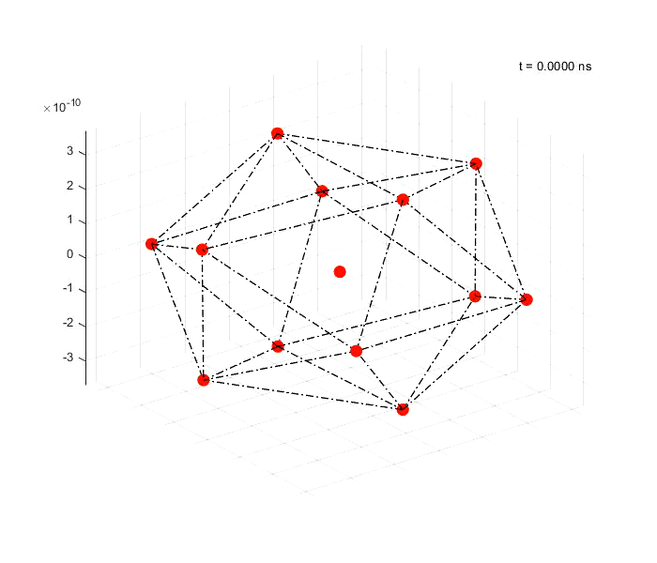
non-zero momenta
pnn = randi([-5 5], Na-1,3);
p_centro = -sum(pnn,1);
p0 = [p_ centro; pnn].*m'*10; % nm/ns

Slide 14
Thanks for the attention

